Slide 1
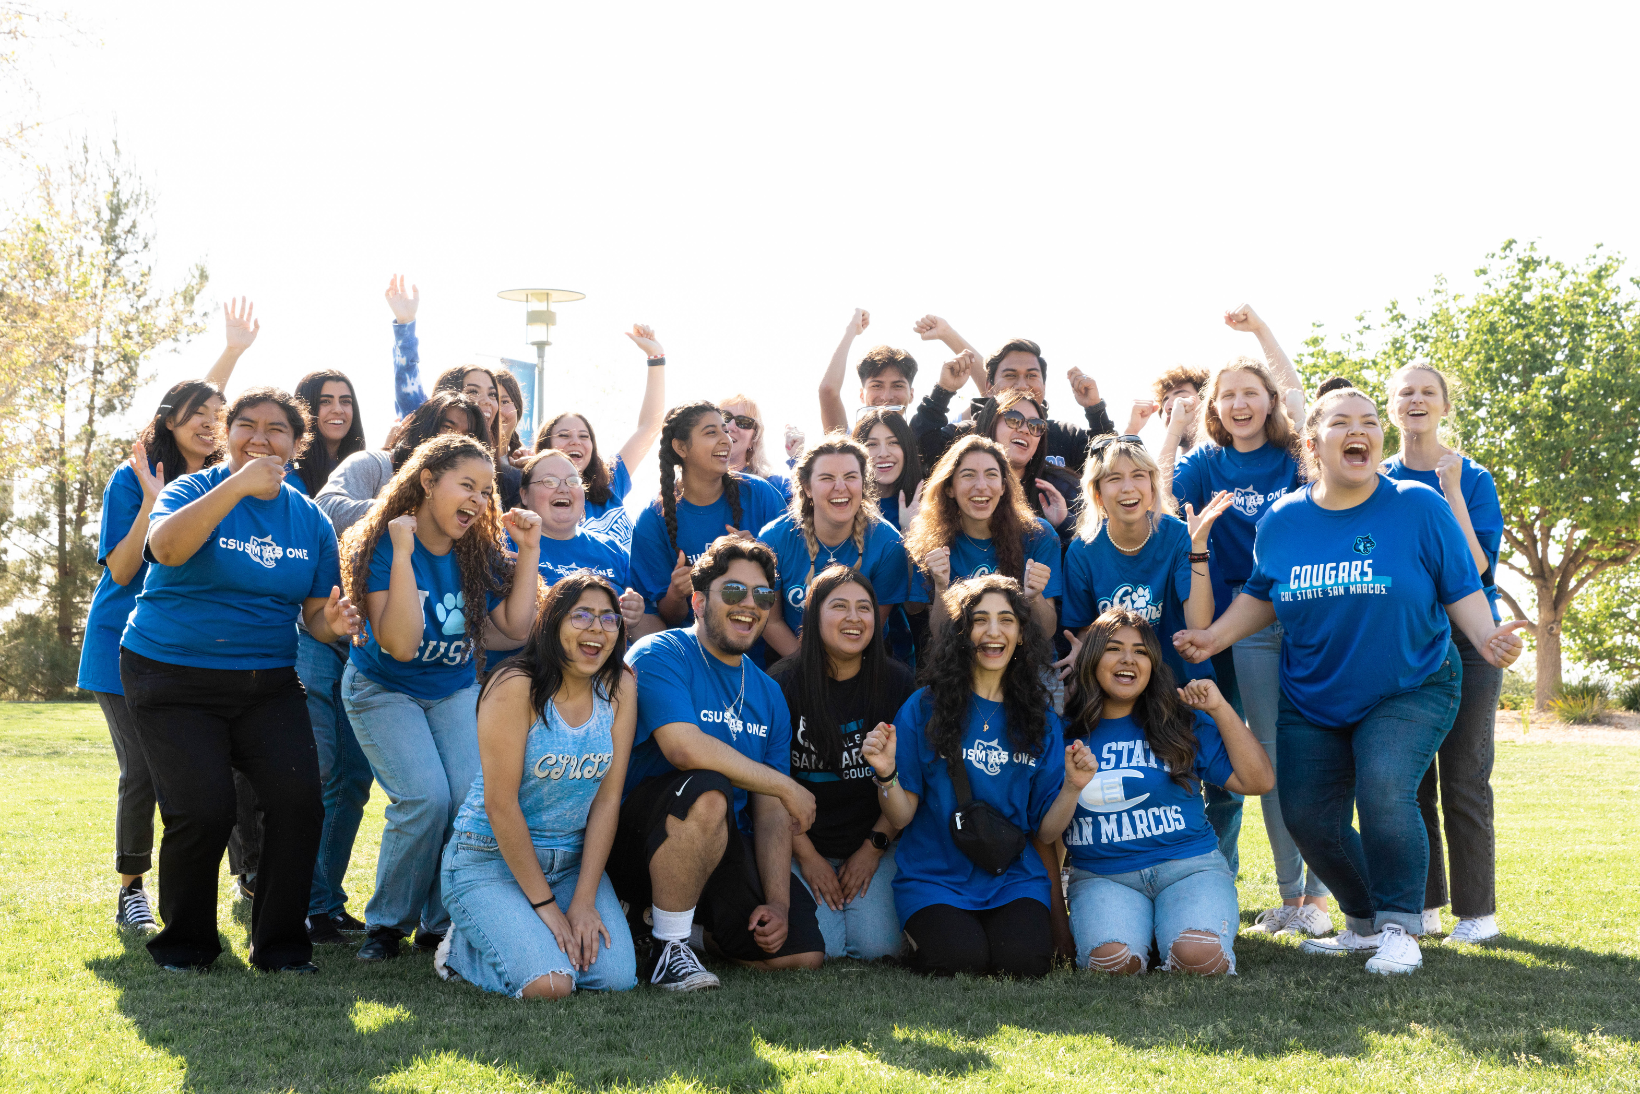
WELCOME TO CSUSM!
OFFICE OF SUCCESS COACHING
success@csusm.edu
Notes:
Take this time to welcome them again to CSUSM and share your excitement to get to know them!
I look forward to working together with your GEL instructor to ensure your success this semester and beyond!

Slide 2
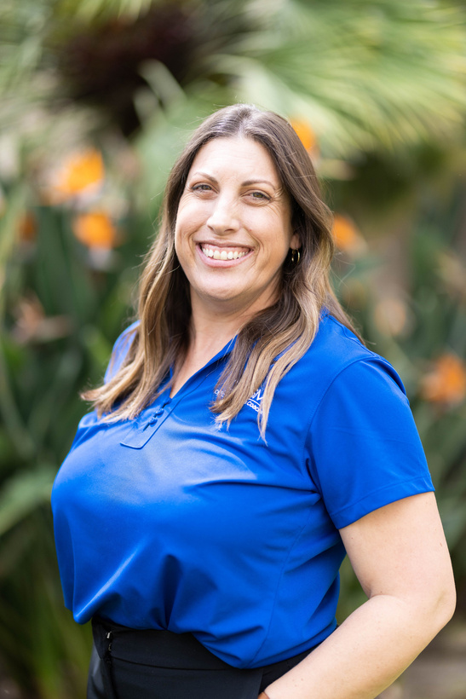
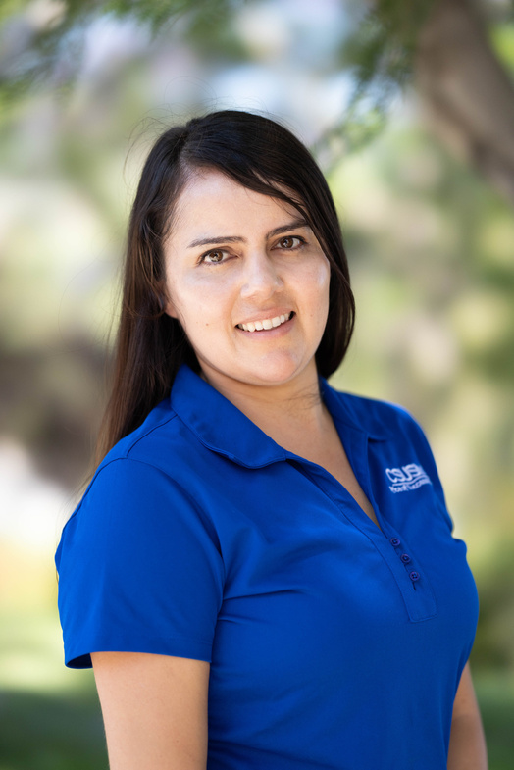
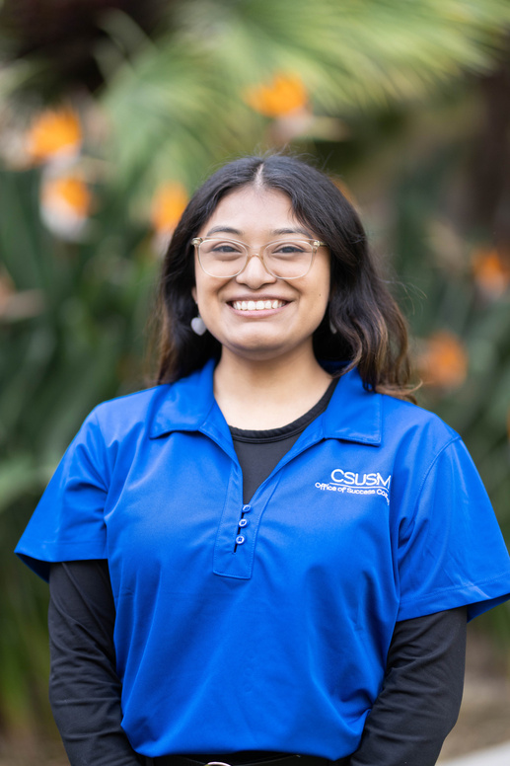
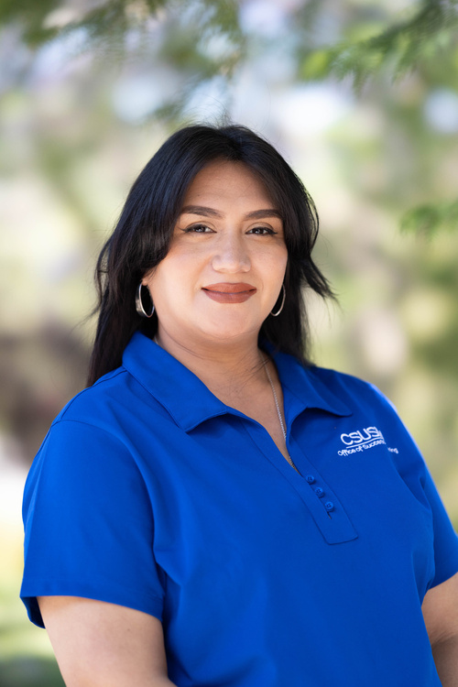
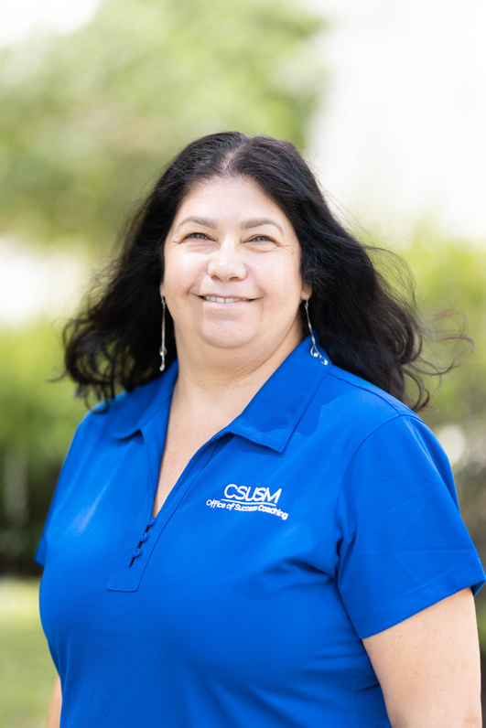
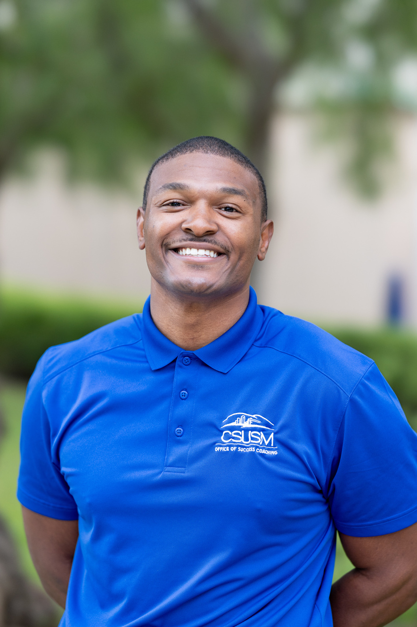
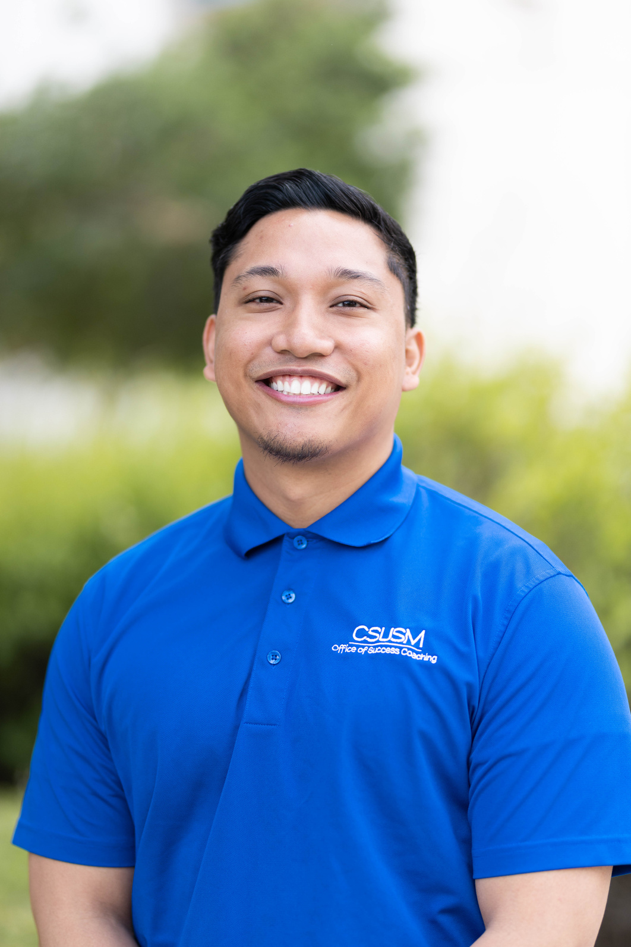
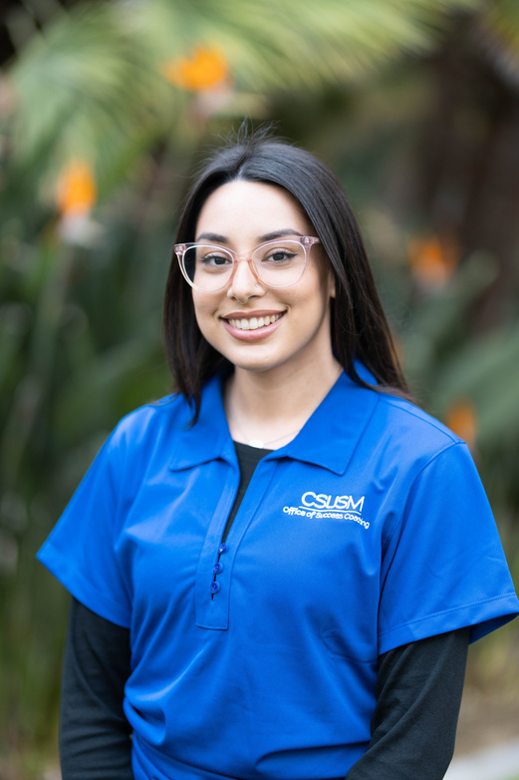
Your Success Coaches
Jennie R.
Trujillo-A-Z
Erika V.
Rosay-Trujillo
Elizabeth H.
Fernandez-Hernandez
Julieana C.
Cano-Felix
Angelina G.
A-Cann
Tyrone W.
Hernandez A-Lyc
Joshua F.
Oro-Rosas
Samantha B.
Lyd-Ore
Notes:
Success Coaches are full-time professional staff at CSUSM, committed to helping first-year students thrive and reach their full potential. You will see how students are assigned on the screen – we will provide information about how to contact your coach at the end of the presentation. In addition to our professional staff, we have fabulous peer success coaches who are students just like you! They are here to provide the student perspective as you make the transition to CSUSM.

Slide 3


What do we do?
We are here to listen, guide you, support you, and cheer you on
One stop shop for students/main contact
Goal setting and discovery
Time management and prioritization
Align your why with the goals set for yourself
Make referrals and resource recommendations
Help form a sense of belonging
Help build self-efficacy
Notes:
Overview of Success Coaching
What do we do?
-We are here to listen, guide you, support you, and cheer you on
-One stop shop for students/main contact
-Goal setting and discovery
-Time management and prioritization
-Align your why with the goals set for yourself
-Make referrals and resource recommendations
-Help form a sense of belonging
-Help build self-efficacy

Slide 4
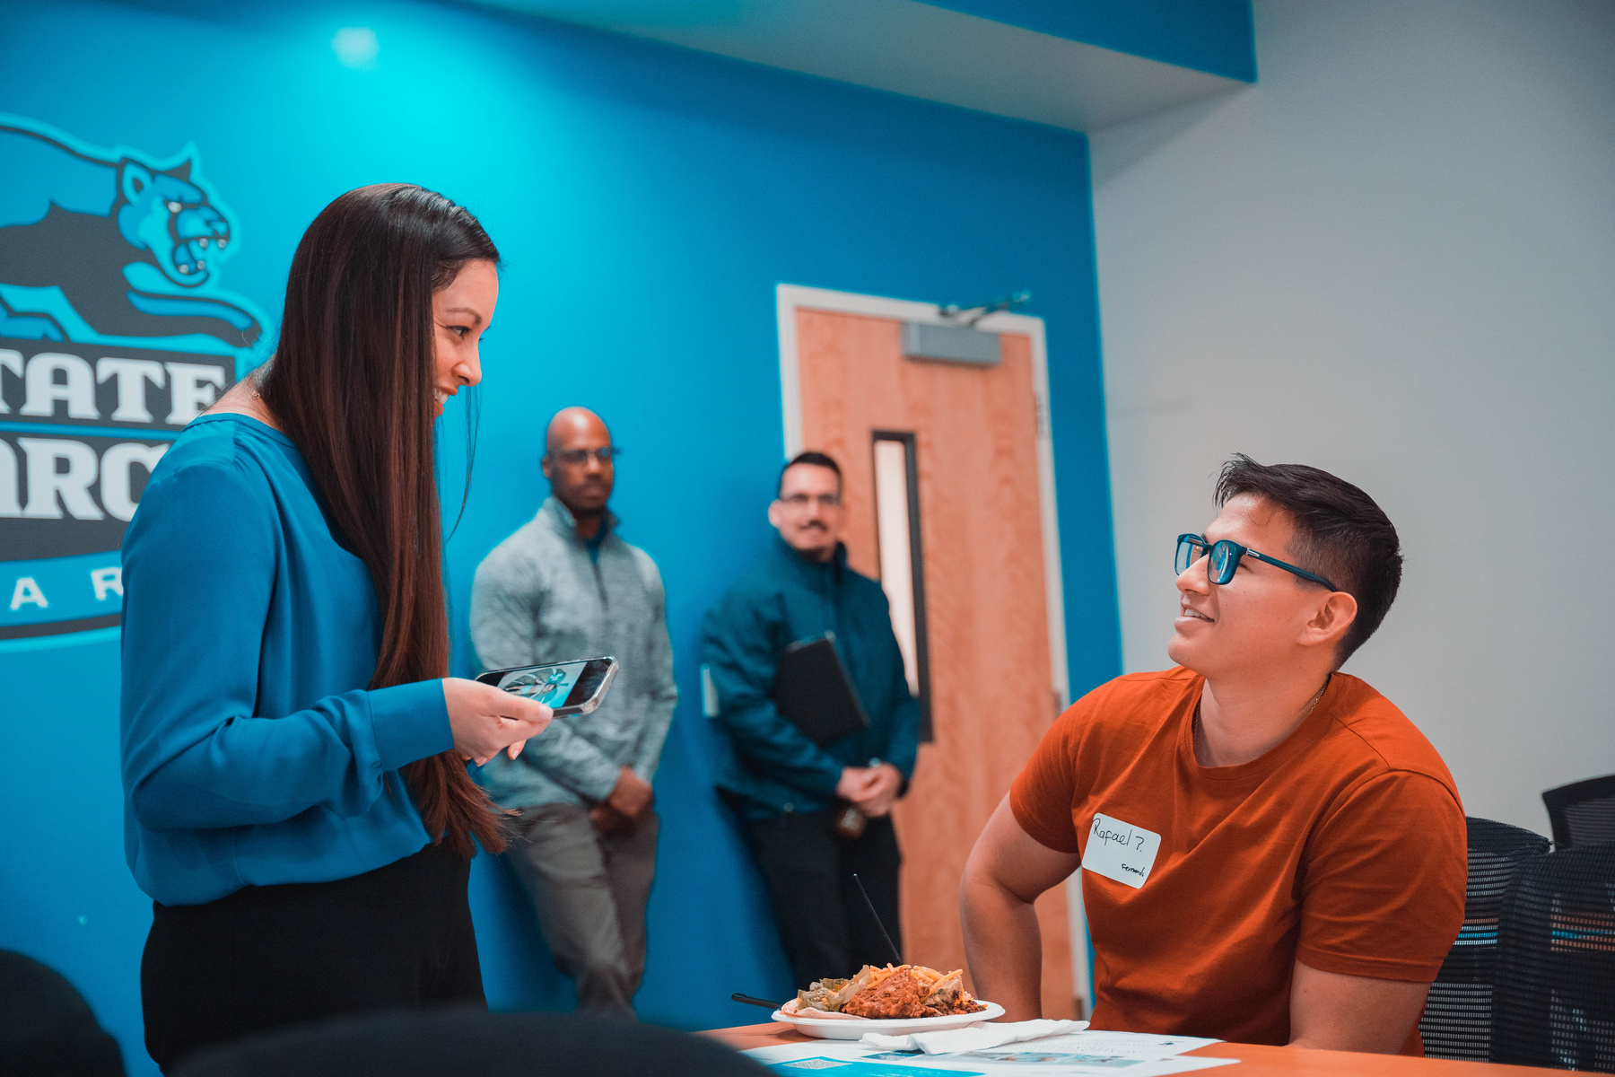
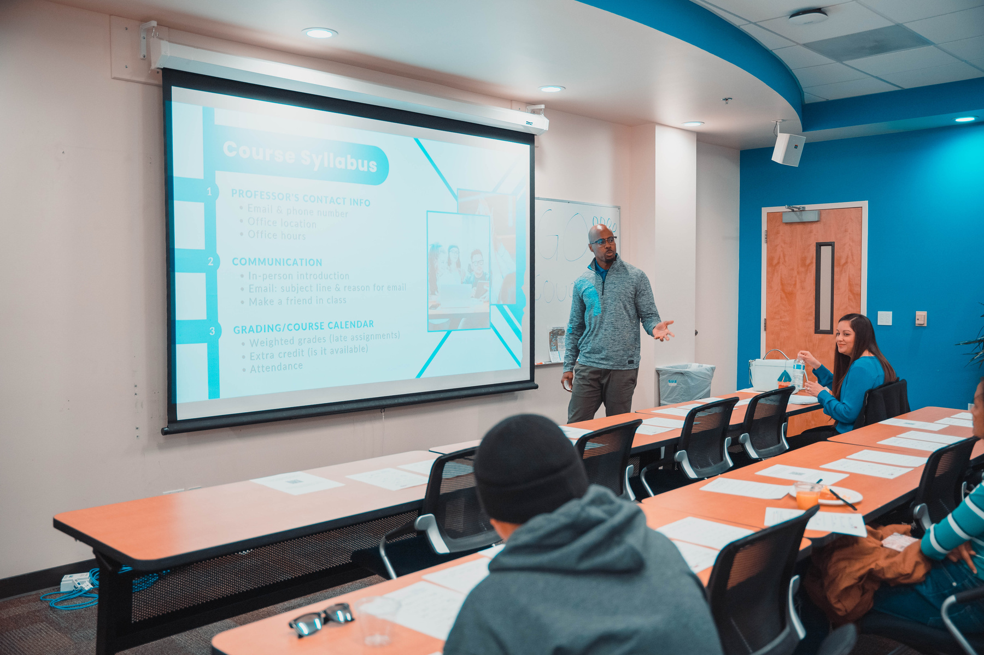
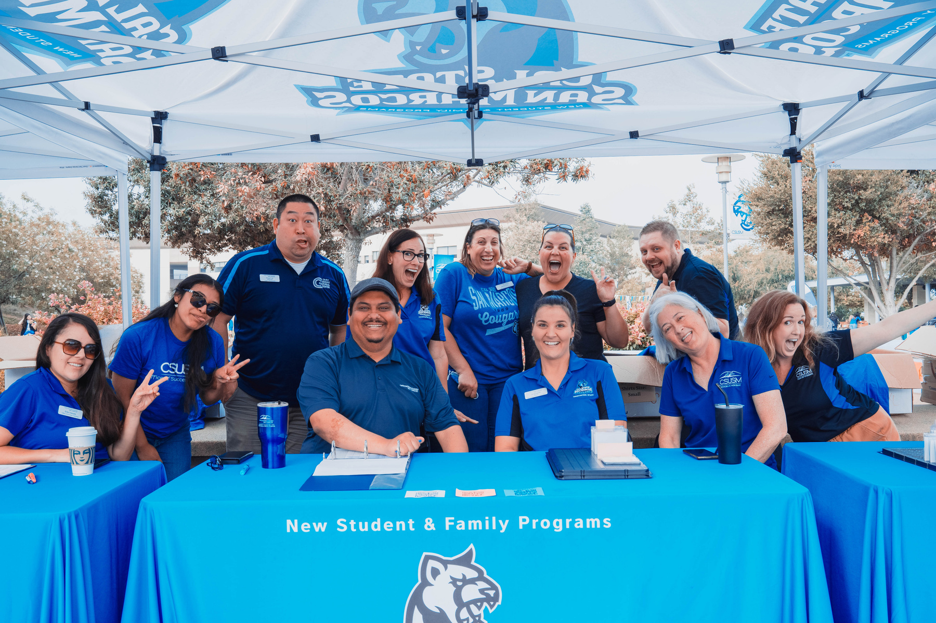
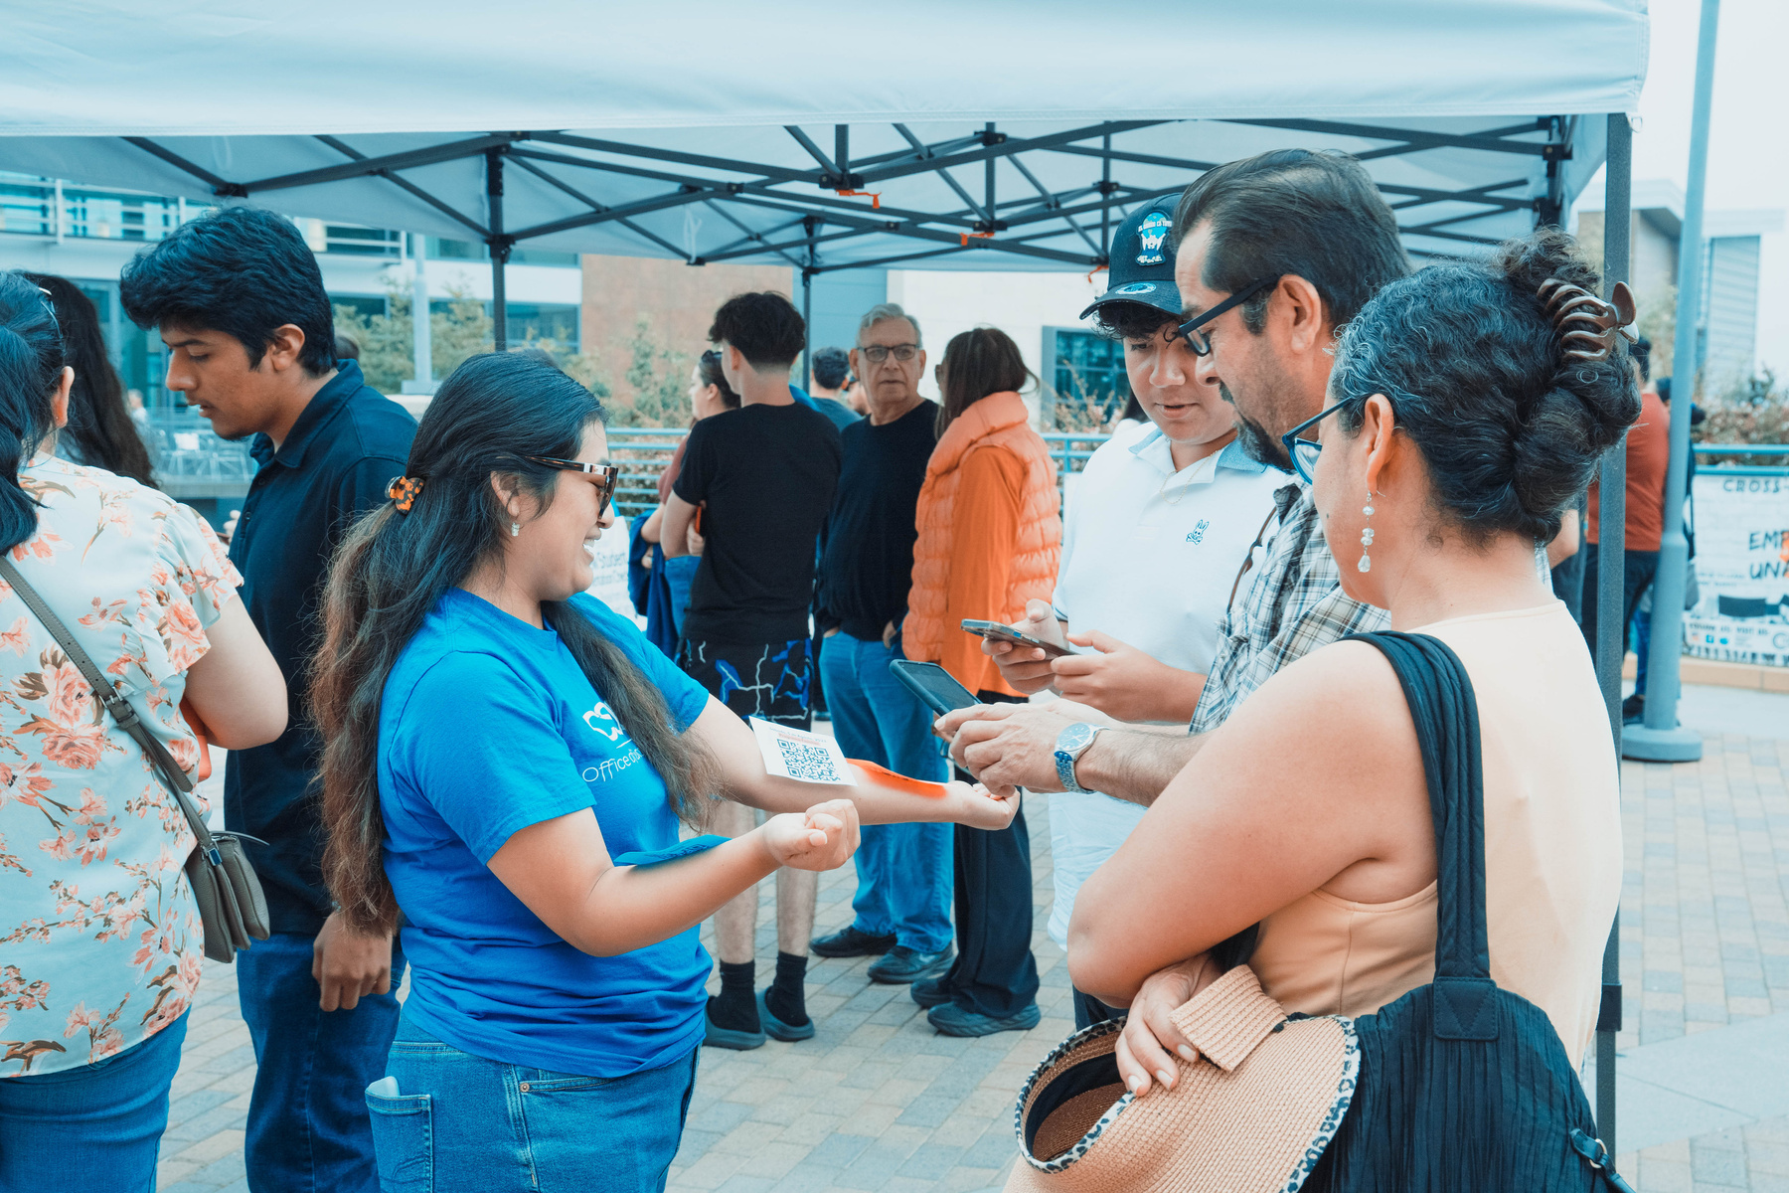
How do we do it?
Success
Workshops
Community
Building
Resource
Connection
1:1 Meetings
Notes:
How do we do this?
-One on one meetings
-Success Coaching Workshops
-Community Building
-Enrollment Support (in collaboration with Academic Advising)
-Resource connection and referrals
-GEL course partnership
-Early Academic Intervention: if you stop attending classes, aren't turning in assignments, or are not engaging to the expected level, your faculty may submit an early academic intervention referral at various times of the semester. If this happens, I will be the one to reach out based on the referral submitted. Please respond :)

Slide 5

Meet with us twice per semester (minimally!)
Meeting last 30-60 minutes depending on the need
Schedule meetings via my Bookings link
Meetings can happen in person or virtually - however you are most comfortable!
Need to reschedule? Please do so with 24-hour notice
Be proactive
Communicate with us
Ask questions
What do we expect?
Notes:
Expectations
Students are expected to meet with their Success Coach minimally twice per semester. More meetings and contacts may occur depending on the student.
Meetings last anywhere from 30-60 minutes, depending on the conversation
Meetings can be scheduled via Bookings and can be done in person, via Teams, phone, or however the student is most comfortable
If a student needs to reschedule a meeting, we request 24 hour notice
Be proactive! Contact me at the first sign of struggle so we can determine the best plan
Communicate your needs – I can’t help you if you don’t share what is going on. I can assure you privacy with our conversations while also ensure compliance with mandatory reporting requirements
No question or need is too small! Ask me something simple in Teams or request a meeting. That is what I am here for.

Slide 6

Upcoming Events
Weeks of Welcome
Wednesday, August 27th, 2pm-6pm
The Makery – 2nd floor of Kellogg Library
Open House for ALL 1st year Students
Monday-Friday, August 25th-September 5th, 9am-5pm
Office of Success Coaching (University Commons 130)
Notes:
Resources and Semester Events
Attend Weeks of Welcome events
You are invited to join us on August 30th between 11am-1pm in the North Commons Lobby to meet coaches and get some helpful resources!
Success Coaching Workshops - you heard the College 101 session this summer and now we will dive in deeper to what we discussed. We are offering a Time Management workshop on (date, time, location) and a session on How to Communicate with Faculty and Understanding your Syllabi on (date, time, location)
You are also invited to come hang out with coaches during university hour once a month at Game On with OSC. Come by to destress and play board games with fellow students! (dates/times)
Towards the end of the semester, we will offer Enrollment workshops and support in collaboration with academic advising. These sessions will happen in November before registration.
Lastly, we want to celebrate your successes at the end of the semester. Our event Sweet Success will occur toward the end of the semester to celebrate the end of your first semester with some sweet treats.

Slide 7

SCHEDULE YOUR FIRST MEETING
What's Next?
FOLLOW US ON SOCIAL MEDIA
CHECK YOUR EMAIL
DOWNLOAD AND TURN ON YOUR TEAMS NOTIFICATIONS
I'M HERE FOR YOU!
Notes:
Closing
Schedule that first meeting!
You’re invited to complete the BCSSE to help me get to know you better!
Follow us on social media!
Success Tips:
Check your email daily
Check your mycsusm weekly
Ask for help early and often
I look forward to working with you!

Slide 8

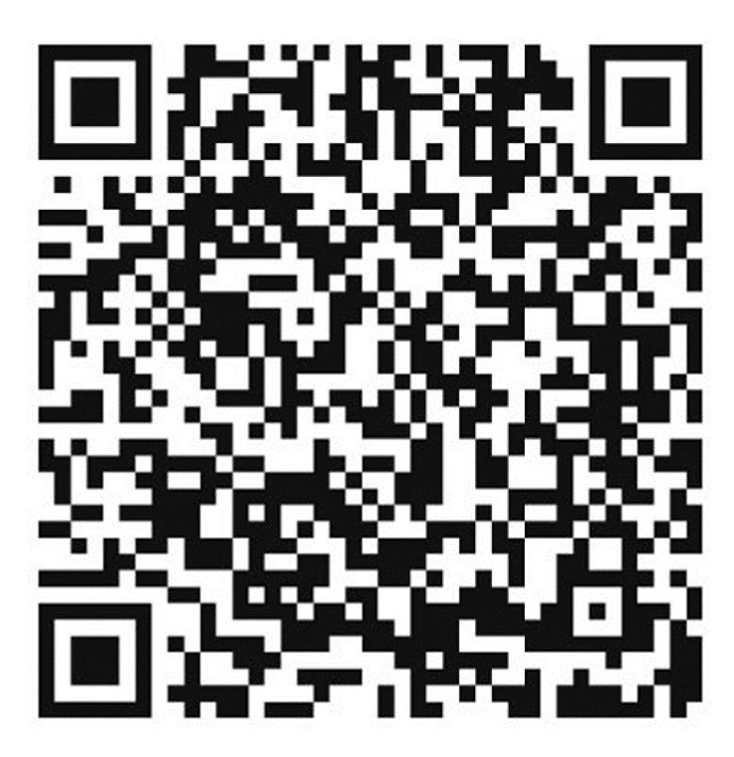

Slide 9


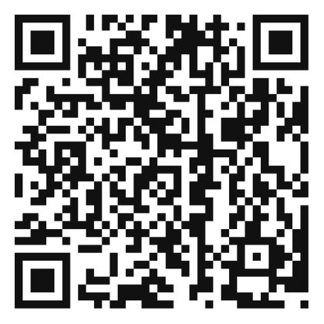

FOLLOW US!
CONTACT US!
success@csusm.edu
Virtual Front Desk
(MS Teams)
Instagram: @csusmsuccess
TikTok: @csusmsuccess
LinkedIn: CSUSM
Student Success

