Slide 1
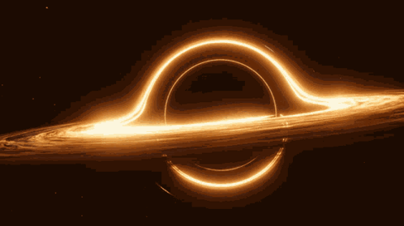

Slide 2
Hawking’s Theory:
He proposed a theory which in short summary said that extreme black holes just couldn’t mathematically exist. But why?
First let's find out what in the hell black holes even are.
Einstein’s general theory of relativity:
According to Einstein’s theory, nothing should be able to escape black holes
Black Holes:
They are created after a dying star, which turns into a supernova but in all that mess there is still a singularity right in the middle of it all, and that’s where gravity starts to be pulled towards and there are two layers the first layer is the singularity and the second is unwanted material that gets pushed out into space.
Extreme Black holes:
As black holes consume or take in mass they spin faster and faster now some of these materials contain some charge so they get charge as well now, and when it reaches a point of having the maximum amount of charge and spin this is when we name it an extreme black hole

Slide 3
Extreme black holes:
They don’t attract anything anymore because they are at their max
But even then if something was to accidentally go towards it, it won’t escape.
In 1973:
Stephen hawking’s with James Bardeen and Brandon Carter proclaimed that these extreme black holes could never exist in the real world. That there was no way they could form, but why?
They introduced 4 laws of black holes
Zeroth, the horizon has a constant surface gravity for a stationary black hole
First, For perturbations of stationary black holes, the change of energy is related to change of area, angular momentum, and electric charge by.
The second law, the horizon area is, assuming the weak energy condition, a non-decreasing function of time
The third law, It is not possible to form a black hole with vanishing surface gravity. That is, κ=0 cannot be achieved.

