Slide 1
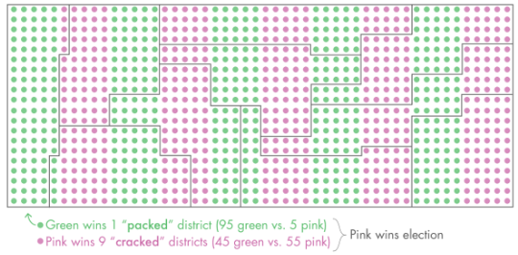
Using Math to Fight Gerrymandering
Partisan Gerrymandering: The practice of drawing voting districts to give one political party an unfair advantage
Example:
Efficacy Gap: a way to calculate the difference between each parties wasted votes as a percentage of the total vote
Nicholas stephanopoulos and eric mcghee proposed that the efficiency gap should be a simple standard they adopt for partisan gerrymandering cases
To be considered unconstitutional:
Exceeds some chosen efficiency gap threshold
The gap is likely to favor the same party over an entire decade

